Slide 1
The Body Sensor Network

Slide 2
Project Overview
Develop an application that can identifying affective experience
  physiological responses
  Especially those for craving for alcohol
    this application is capable of doing this
Create classifiable data to differentiate between different mood states
  Data collected will be tested against a trained model

Slide 3
Survey
A system of survey scheduling and file writing necessary in development
There are six modules or item parcels are administered on the phone:
  I. Morning or Wake-Up Report Item Parcel-completed by all subjects each day
  II. Random Assessment / Prompt Item Parcel-completed by all subjects six times per day, and as prompted by physiological signatures.
  III. Initial Drinking Episode Item Parcel-completed only when an alcoholic drink is logged by participant
  IV. Drinking Follow-Up Assessments – to be administered at 30 mins, 60 mins, 120 mins following the participants’ logging the first drink.
  V. Craving Episode Item Parcel-initiated by participant and completed only when participant craves an alcoholic drink.
  VI. Mood Dysregulation Episode Item Parcel- initiated by participant and completed only when participant experiences a significant change in mood state.

Slide 4
cont..
Survey questions were written as XML files
Used SAX parser to display on phone
  Simple API for XML
  Event driven Parser when file reaches a tag give instructions for printing.
  Example questions:

Slide 5
Example questions
ALCOHOL URGE/CRAVING
PAST 15 MINUTES (1 = not at all, 5 = extremely)
(1) Did you CRAVE A DRINK?
SMOKING URGE/CRAVING
PAST 15 MINUTES (1 = not at all, 5 = extremely)
Did you CRAVE A CIGARETTE?
ALCOHOL INTOXICATION SYMPTOMS
PAST 15 MINUTES (1 = not at all, 5 = extremely)
Did you feel SLUGGISH?
Did you feel BUZZED?
Did you feel DIZZY?
_ other
HANGOVER/HANGOVER SYMPTOMS
PAST 15 MINUTES (1 = not at all, 5 = extremely)
Have you had a HEADACHE?
Have you felt NAUSEOUS?
SITUATION AND SETTING
(1) In the PAST 15 MINUTES, WHO have you been with: (Check all that apply)
Note: We will lock out other responses if “no one” is checked.
_ no one
_ partner/spouse
_ friend/acquaintance
_ other
(2) WHERE is your current location? (Check all that apply)
_ home
_ work
_ bar/restaurant
_ outside
_ other public place

Slide 6
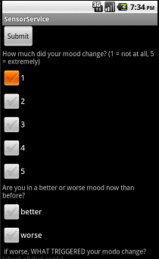
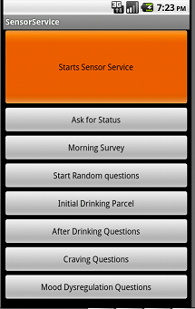
Application pics

Slide 7
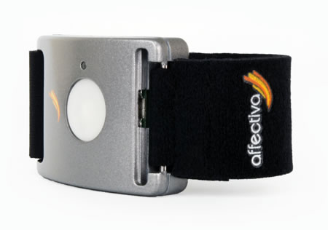
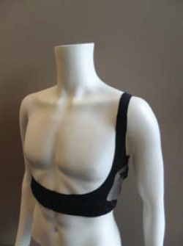
Sensor
Q- Sensor
Uses bluetooth file transfer protocol.
Collects temperature, potion, skin conductance
Wearability
Also uses position for android however other android internal sensors are easily activated.
Equivital -respiration, heart rate/variability, oxygen saturation

Slide 8
Results
The following graphs show the different aspects of accelerometer data being classified into three states.
Idle, walking, climbing stairs,
  Running and other activities attempted
  Connectivity problems, Bluetooth
  Subclasses: type, time, name, Qx1y1z1, Ax1y1z1

Slide 9
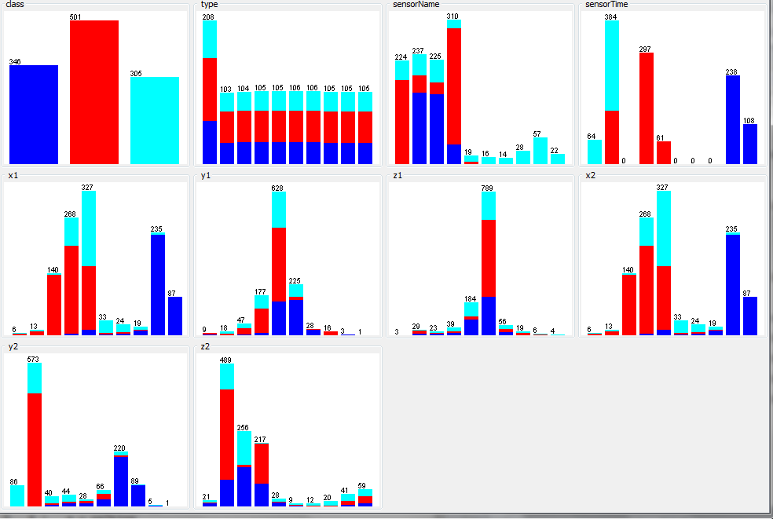

Slide 10
Results cont
1.accelormeter data confusion tables
- Done with 97% accuracy
2.predictions for Physiological data: based on regular activities (no problems with emotion dysregulation or substance craving)?.
heart rate..
heart rate variability
temperature
more physiological data....

Slide 11
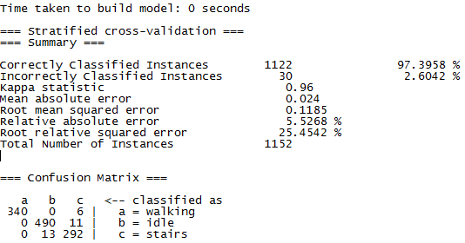

Slide 12
Future work
The work presented here only touches the surface of the requirements needed to get the experiment fully functional.
refinement of the data classifiers. the sensors are capable of gathering vast amounts of physiological data like skin
Classifying this data based off of survey data .
use of time stamps
still exists some file I/O and Bluetooth connectivity issues,
more complex data.
avoid data corruption.
distribution of the program’s surveys. The Graphical elements of the surveys may benefit from additional formatting as well to insure that

Slide 13
Conclusions
In the information age, smartphones have become a way of life. We have only begun to tap into the true potential of this smartphone technology.
Smart phones sensors are becoming exponentially more sophisticated and applicable to every day activities

Slide 14
References
1. Trull, T. Grant Proposal Remote wireless sensing network for the assessment of emotion dysregulation and craving for substance use. 2012
2. Miller, G. The Smartphone Psychology Manifesto Perspectives on Psychological Science 2012.
3. Affectiva Inc. 2012 Q-Sensors. http://www.affectiva.com/q-sensor/.

